Slide 1
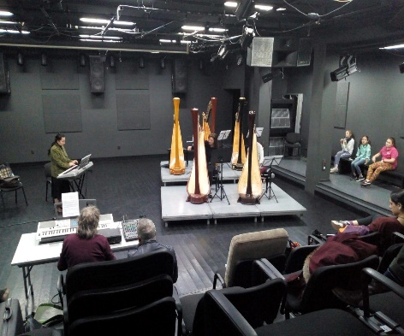
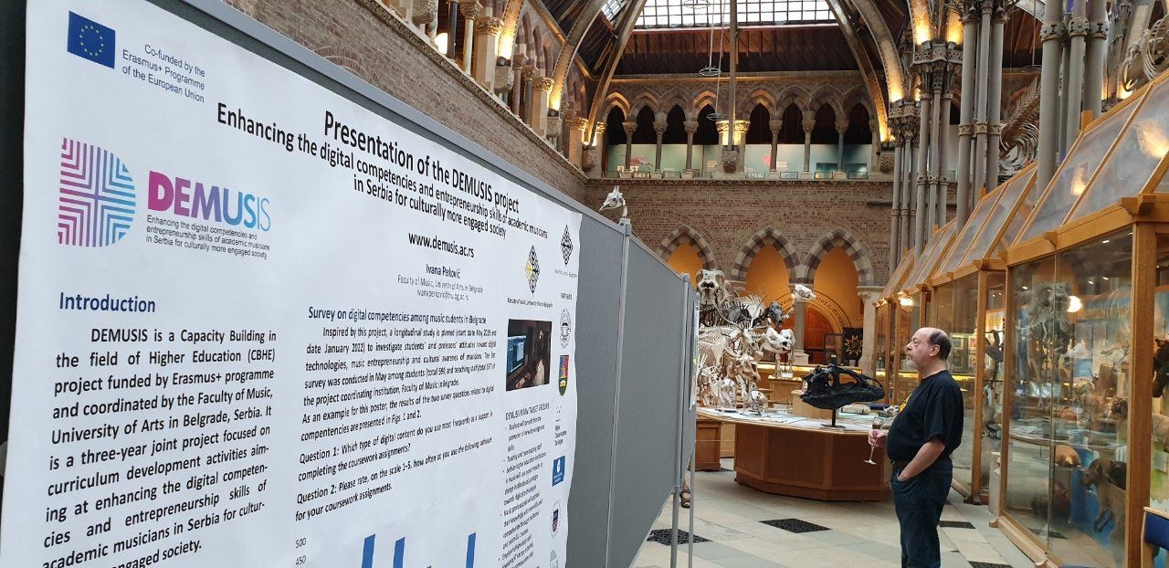
DEMUSIS: Enhancing the digital competencies and entrepreneurship skills of academic musicians in Serbia for culturally more engaged society
entrepreneurship in music |digital media | eLearning
DEMUSIS is a Capacity Building in the field of Higher Education (CBHE) project funded by Erasmus+ programme and coordinated by the University of Arts in Belgrade, Serbia. It is a three-year (2019-2022) joint project focused on curriculum development activities aiming at enhancing the digital competencies and entrepreneurship skills of academic musicians in Serbia for culturally more engaged society.
Insert the following information:
partner institution
description of focus in the project
description and some pictures of project related actions
status of project implementation
You can rearrange the pictures and general texts, but please don‘t skip any logos or information.
Please use Myriad Pro or Segoe UI
Colours of text, lines and boxes predefined as:
Blue, Light Blue, Pink
www.demusis.ac.rs
This project has been funded with support from the European Commission.
(logos of relevant partners)

