Slide 1
Quality assurance strategies, tools and recommendations for the implementation of international cooperation projects
Paula Ranne, Deputy Director
European Association for the Quality Assurance of Higher Education (ENQA)
Erasmus+ Capacity Building in Higher Education Grantholders’ Meeting
29 January 2019

Slide 2

European Association for Quality Assurance in Higher Education (ENQA)
Umbrella NGO for European quality assurance agencies
Network in 2000; association in 2004
53 Members in 29 countries, 56 Affiliates in 31 countries

Slide 3
European Association for Quality Assurance in Higher Education (ENQA)
Consultative member in the Bologna Follow-up Group since 2005
Co-operation within E4 (European University Association, European Students Union, European Association of Institutions in Higher Education)
Founding member of the European Quality Assurance Register (EQAR)

Slide 4
Standards and Guidelines for Quality Assurance in the EHEA (ESG)
PART 1. INTERNAL QUALITY ASSURANCE
PART 2. EXTERNAL QUALITY ASSURANCE
PART 3. QUALITY ASSURANCE AGENCIES

Slide 5
Principles for quality assurance
Higher education institutions have the primary responsibility
Responds to the diversity of HE systems
Serves a variety of purposes: enhancement – accountability
Provides transparent and independent information
Involves stakeholders
External and internal QA build on each other
Supports the development of a quality culture

Slide 6
QUALITY PLAN
Can support the project development and provide feedback on the extent the objectives are accomplished;
Can allow results to be improved by comparing the identified objectives and the established processes;
Can support the project decision-making process by evaluating the results;
Can monitor the involvement of project partners and other stakeholders;
Can monitor the chosen means used and the level of efficiency of implementation;
Can identify any risks and issues related to implementation, alert the coordinator and propose solutions.

Slide 7
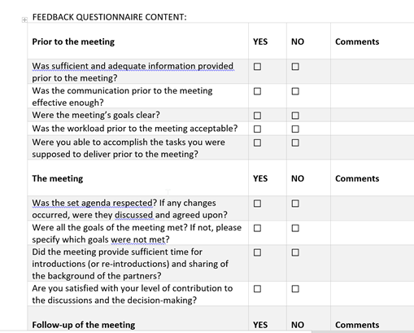
QUALITY PLAN
Be serious about it – it can support you.
Don’t leave it behind.

Slide 8
QUALITY PLAN
Keep QA monitoring simple, light and user friendly.
Integrate it in the workplan.
Assign a quality coordinator or team to oversee.
Use indicators that you can understand.
Use means that are simple.
External evaluation / evaluator can be useful.
Ask your QA unit for inspiration.
Pay attention to using feedback, not just collecting it.
It is largely about self-reflection.
Quality is not just about delivering the deliverables…

Slide 9
WORKPLAN AND BUDGET
COMMUNICATION
MOTIVATION

Slide 10
WORKPLAN AND BUDGET
Be the quality ambassador.
Know your workplan and budget by heart.
At the same time: Learn to adjust and to delegate.
Ask early.
Be serious about your reporting duties.
Remind your colleagues about the aims of the work.
Be strategic about deadlines.

Slide 11
COMMUNICATION
Even if it is your priority, it is not everyone’s priority…
Communicate concisely, responsibly yet openly.
Get to know your colleagues.
Create an open space for questions and answers.
Be sensitive to context in everything that you do.

Slide 12
MOTIVATION
Do not underestimate the importance of social activities.
If tensions build, be prepared to mediate.
Forgive yourself for not being a superhuman.
Be aware about the emotional burden.
Be the enthusiast and enjoy what you are doing.
Project coordination is an attitude.

Slide 13

It does not matter so much what we are doing - as long as we are creating dialogue and building bridges.

Slide 14






Slide 15

Thank you!

