Slide 1
Erasmus+ Capacity Building in Higher Education
Networking and Synergies
among projects in the Western Balkans
Grant Holders Meeting
28-29 January 2019
Notes:
Introduction of the section and the people (EACEA)

Slide 2
CBHE Results Western Balkans
(selected and coordinated)
2015
15/6
2016
18/11
2017
16/10
2018
19/13

Slide 3
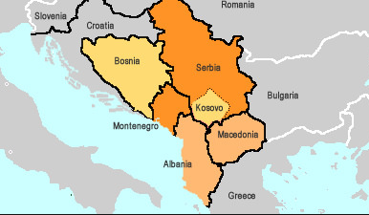
Participation per country
Notes:
AL – 6
BA – 8
ME – 6
RS – 12
XK – 6

Slide 4
WB results 2018: out of 19 projects
Notes:
partner / coordinator / instances
Serbia 178 25 203
Montenegro 39 3 42
Kosovo* 59 5 64
Bosnia and Herzegovina 114 3 117
Albania 74 4 78

Slide 5
WB results 2018: out of 19 projects
7 National Projects (4RS-1BA-1XK-1AL)
1 Structural Projects (ME and AL)
9 Regional (at least 2 WB countries cooperate – 1 has 5 WB countries)
3 Cross regional (with RU, AM, UZ and IL)
13 Coordinated by WB Institutions
8 by RS HEIs 2 by XK HEIs
2 by AL HEIs 1 by ME HEIs

Slide 6
New Strategy – February 2018
A credible enlargement perspective
for and enhanced EU engagement
with the Western Balkans
→ Supporting socio-economic development
→ Launching a Digital Agenda
→ Supporting reconciliation and good neighbourly relations
Notes:
The role of education must be given a higher priority especially in terms of fostering greater tolerance, promoting European values and strengthening the cohesion of society. The Western Balkans should invest more in their younger generation, our future EU citizens, and give them a perspective for the future, not the past. Cooperation in the field of culture with and within the region should also be enhanced.

Slide 7
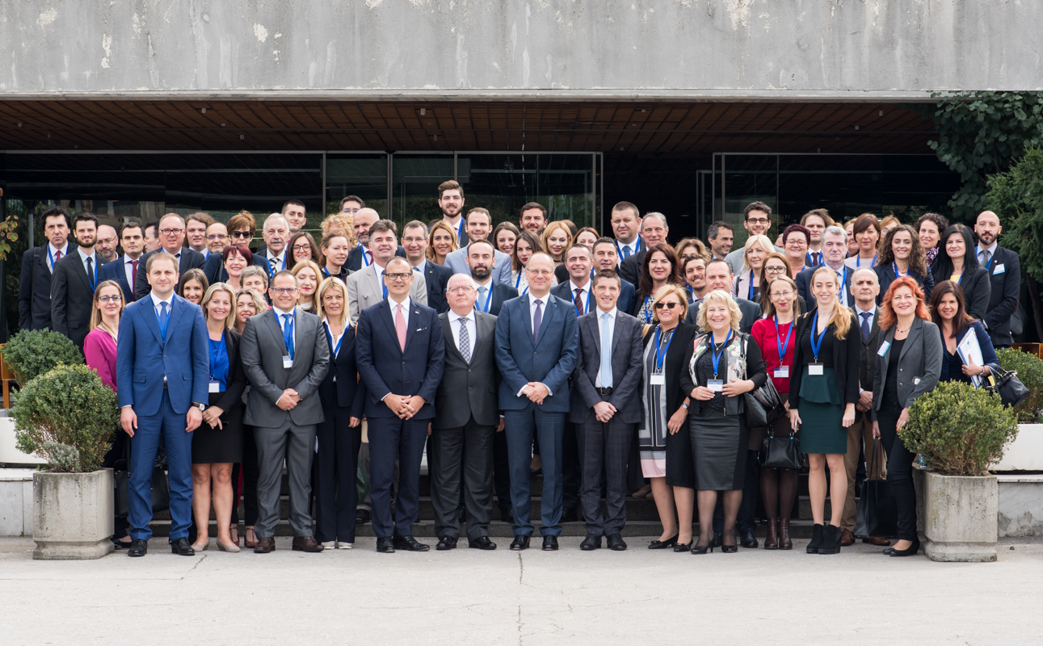
Regional dialogue Western Balkan Platform on Education and Training

Slide 8
Other initiatives
TIMSS & PIRLS
RYCO
Young Civil Servants Scheme
Berlin-Process
Mobility and reconciliation
1st call 0.5 m €
2019 – Science and Mathematics
2021 – Reading and literacy
IEA
2nd call
15 civil servants
5 months training Ecole Nationale d’Administration

Slide 9
Other initiatives
VET pilot scheme
SELFIE HEInnovation
WBAA
Alumni Association
12 National Representatives
I GA Tirana March
Learners and teachers
400-500 mobilities
Call to be launched February 2019
Digital skills – schools
Innovation and entrepreneurial skills - HEIs

Slide 10
Common political challenges in HE in the Western Balkan region
Recognition of qualifications (Ministerial priority of last year)
Inclusion and access to equitable education (special focus in the new Programme post 2020)
VET sector reforms (new VET pilot scheme + 2019 Ministerial main topic)
Governance of HEIs
Internationalisation of HEIs
Teacher Education
University – world of work cooperation

Slide 11
Activity part A
Notes:
Distribution of the card
They to find their similar.
Result: 5 different groups

Slide 12
Grouping of 2018 projects by project profiles/topics/themes
1. AGRICULTURE and ENVIRONMENT
SWARM
SETOF
HarISA
ALMARS
STEPS
2. Teacher Education
TeComp
ITEM
PPMA
SMAHPC
KEY
3. University – enterprise cooperation and entrepreneurship
All4R&D
DEMUSIS
ADA
4. Engineering and architecture
SENVIBE
HURBE
TRAFSAF
5. Structural reforms
e-VIVA
MARDS

Slide 13
Activity part B
Notes:
Distribution of questions per each group and discussion

Slide 14
What have I learned from this discussion?
Did you meet new people?
Can you use these contacts during your project implementation?
Did you get to know new institutions you could work with in the future?
Any synergies that could be developed with other projects?
Have you identified among the policy
challenges in the field of HE some issues
that your project might tackle?

