Slide 1
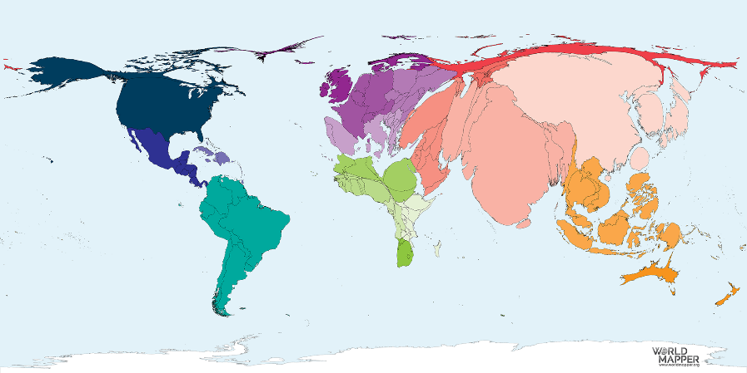
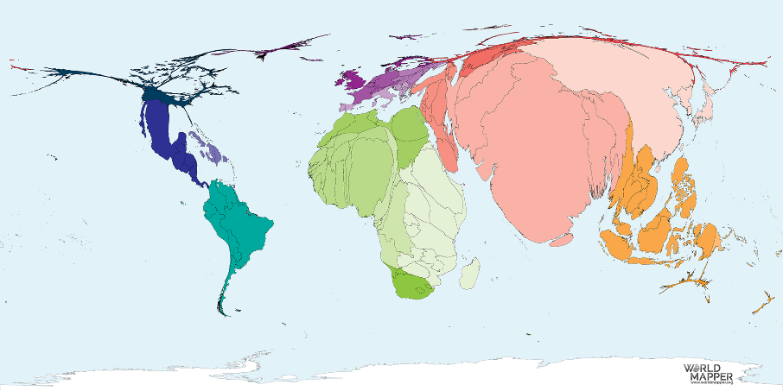
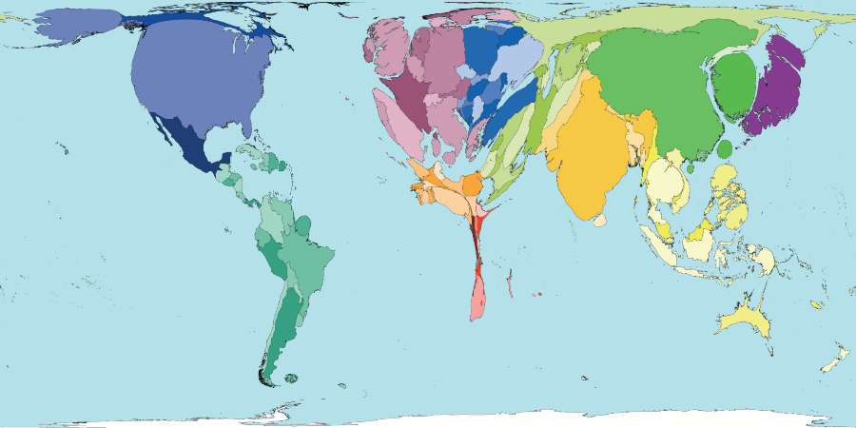
Implementing and Monitoring your CBHE project
CBHE Grant Holders' Meeting- Brussels, 28-29 January 2019
Notes:
Welcome to this first plenary session of the 4th CBHE grant holders meeting.
During these two day we will try to sensitize you to
the most important administrative, financial and contractual aspects of your future journey as beneficiaries of a CBHE grant but also to
the fact that your project is part of a bigger picture that involves at the lower scale the community of CBHE projects and at a broader scale the European and worldwide cooperation and development objectives that, through the vehicle of HE, aim at making our world more inclusive and egalitarian.
This introductory slide could give a us a first indication of the challenges ahead of us. It dates from the beginning of the 21st century and presents the world proportionally to the enrolment in HE. It gives a striking vision of those regions of the world were a lot remains to be done and it can be compared to the reverse image of this second map which shows the proportion of young population not enrolled in HE.
If we add that beyond the efforts to increase HE enrolment figures, we should also be concerned by the quality, inclusiveness, relevance of the HE offer available in most parts of the world, we can see that the challenge ahead of us is huge

Slide 2
PRESENTATION CONTENT
The CBHE Community
The CBHE projects
Your partners & stakeholders
(Some) Rules and regulations
Your Grant Agreement
Your internal management rules
Monitoring your project
Notes:
So let's look at the content of this first plenary session.
We will first try to present who you are, who are those seated next to you, who are the individuals and bodies with whom you will work for the two or three years of your project.
We will then look at some of the rules and regulations under which your cooperation activities will be implemented. In this respect, I would like to apologise for the fact that I've limited this section to half a dozen aspects of the administrative and contractual framework under which your project will work. In reality, I should not apologise and you should thank me for not addressing individually each of the 125 different articles described in the G.A. signed with the Agency. In addition, the most crucial aspects of these regulations concern the spending of your project grant and these will be addressed in detail by my colleagues in the next session
And finally we will briefly address the way you will interact with our Agency during the project implementation phase.
I would like to ask the participants already involved in CBHE projects from previous generations (2015 to 2017) to stand up.
Well colleagues, I need to warn you: as compared to previous years, there are not so many changes in the administrative, contractual and financial management of CBHE projects and I must apologise in advance if during this 4th GH meeting we repeat advises and recommendations you have heard in previous events. In any case, the weather is shity, on Monday Brussels museums are closed, there is good catering and there is no better place than this MCE building for networking, exchanging experiences and preparing future cooperation projects.
Now newcomers stand up please (i.e those for whom this is the first experience as beneficiary of a CBHE grant)
First of all, welcome to all of you. I need to warn you: during two days you will be bombarded with information. You will listen, speak, eat, drink, even dream of CBHE. And trust me, this is only the beginning ! If you don't believe me, you can always ask these other guys who stood up prior to you. Let me correct myself: you must ask them because they are also here to help you, warn you, to ensure you do not face the same problems they have faced and, hopefully, overcome. So, please use their expertise as much as the one of the Agency, Commission and national bodies colleagues present during these two days.

Slide 3
CBHE 2018
147 successful projects
Involving 107 different countries (76 Prtnr. Ctry vs 32 Prog. Ctry.)
Distributed in 133 JPs and 14 SPs
They will work at
National level (61)
Regional level ( 69)
Cross-regional level (17)
44 (30%) are coordinated by Partner Country universities (+29% vs 2017)
Each project involve approx. 12 partners in average (max. 24)
Erasmus+
Notes:
147 selected our of 887 applicants
6,4% increase in demand
16,5% success rate
107 different countries : 76 Partner countries / 31 Programme Countries
These 147 CBHE projects are distributed among
133 Joint Projects (90%)
14 Structural Projects: 14 (10%)
61 National projects (41,5%)
86 Multi-country projects (58,5%) of which 69 regional + 17 cross-regional (RU = 10!)
44 Projects are coordinated by a Partner Country university (30,5%) + 29% increase compared to 2017)
Average size: 12 partners (min 4, max. 24 !!!)

Slide 4
CBHE 2018 - Thematic coverage
Erasmus+

Slide 5
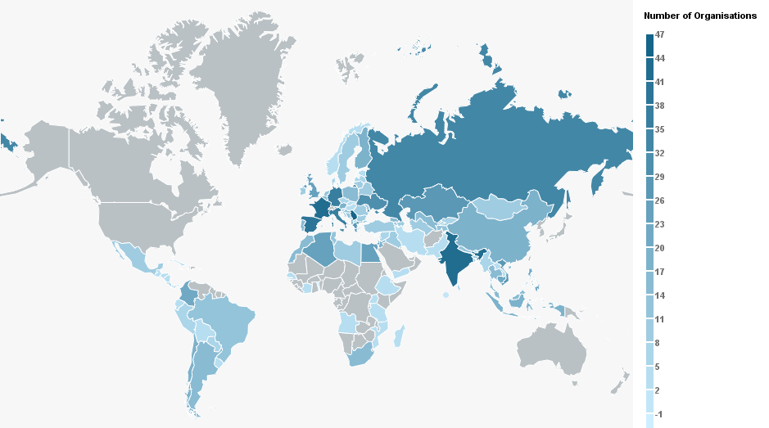
CBHE 2018: 1248 Organisations (1693 participations) involved in 147 Projects
R4
10
R1
18
R2
15
R7
10
R3
30
R9
2
R6
44
R8
15
R11
7
R10
5
Notes:
This it the way your 147 projects are distributed across the globe
The intensity of blue shows you the number of participations in each country (organisations are counted as many times as the number of projects they appear in)
Some observations
AFRICA a lot of grey areas they mean that no project will be implemented in these countries
AFGHANISTAN, Papua New-Guinea, Venezuela are other countries clearly visible on the map with no project in 2018
In terms of active participants: INDIA, SERBIA (last year as partner country), Russia, Kazakhstan, Ukraine, Algeria, Egypt, Colombia…
IN terms of number of projects per region we can see that ASIA and the MEDITERANEAN regions are those with more projects (/the largest allocated budget) followed by the WESTERN BLKNS, EASTERN EUROPE and LATIN AMERICA
As we could see in the first two slides of the presentation a lot remains to be done for implementing more CBHE projects in sub-saharian Africa

Slide 6
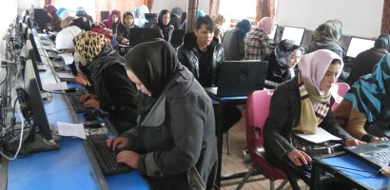
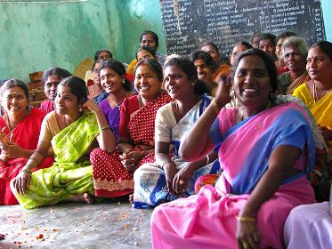
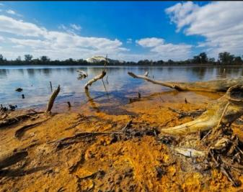
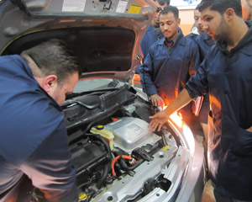
CBHE 2018 : Behind the figures
Notes:
We believed it would be interesting to show what lies behind these figures, what type of are projects are these CBHE projects
For that I will kindly invite the representatives of 5 CBHE projects to come to the stage and to tell us in a few words what will their project be, i.e.
To what needs does it respond ?
How has it been prepared ?
What are the expected ouputs after the funding period ?
I would like to reassure the 142 projects I will not invite on the stage: I have no reason to doubts that yours are as certainly as good as those that will be presented, but with the support of my colleagues in the Agency we wanted to show you a diverse picture of what will be CBHE in action as from 2019.
I Invite the project representatives to be brief otherwise I will not hesitate to take back the microphone

Slide 7
598477: SUGGEST/SUGERE Sustainability and Wise Use of Geological Resources
Project Coordinator:
University of Coimbra, Portugal
Participating countries:
(AO, MZ, CV, PT, ES, IT)
Region:
11 – ACP Countries
Short description:
The SUGGEST project aims to improve the quality of higher education in Africa introducing five (5) degrees on Geology, Geological engineering and Mining Engineering in Angola, Mozambique and Cape Verde. The wider objective is to improve sustainable use of mineral resources, tackle root causes of poverty and aims at inclusive growth by integrating local economic development into the curricula.
In addition, the project aims establish a Geosciences Network of African, Caribbean and Pacific countries by 2020.
Notes:
Nelson Rodrigues - University of Coimbra
Sónia Silva Victória - University of Cape Verde
Angola, Mozambique, Cape Verde
In line with the national strategies of the Development and Education in the target countries the project addresses sustainable use of mineral recourses, tackles root causes of poverty and aims at inclusive growth
Individual/local level: Mining and Geology related areas are considered as highly attractive for ACP young generation of university candidates.
The students will receive training that meets the modern requirements in the mining industry,
development of students start-up projects;
The project aims to foster equality and opportunities for the disadvantages groups aiming to get enrolled a certain % of women and disadvantaged groups for the degree
Institutional level
Regional level – improvement of national mining standards, quality and production, and social services;
European level – employment in the EU, development of joint educational and R&D projects with EU enterprises, establishment subsidiary of EU enterprises in ACP countries;
The project final result will be:
Five (5) Mining/Geology degrees on BSc, MSc and PHD level
Establish a Geosciences Network In African Caribbean and Pacific Countries by 2020

Slide 8
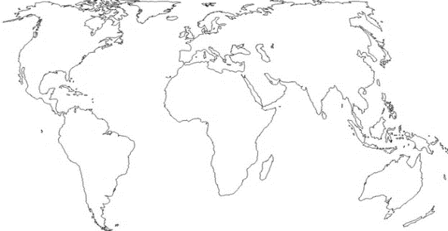
598437 RefTeCp: Refugee Teaching Certification Program for Egyptian and Refugee Teachers Enabled by Blended Learning
Project Coordinator:
FREDERICK University (CY)
Participating countries:
(Cy, UK, El, EG)
Region:
3 – Southern Mediterranean Countries
Short description:
Qualified educators and practitioners related to the refugee crisis in the Middle East region are needed to respond to needs of children and youth affected . The project adopts an inter/multidisciplinary, holistic and systemic approach that aims to build and strengthen the capacities of students, faculty, educators including refugee teachers (blended in-service teacher training program, aligning curricula, e-tool kit, Euro-Arab Refugee Teacher Network)
Notes:
Onoufriou Alexandros from Frederick University (Cyprus)
Ramzy Omar from Heliopolis University For Sustainable Development (Cairo)

Slide 9
598428-EPP-1-2018-JO-CBHE-JP
JOB-JO (Promoting youth employment in remote areas in Jordan)
Project Coordinator:
Jordan MUTAH UNIVERSITY LTD (JO)
Participating countries:
(7 JO, 2 DE, 1 PT, 1 CY)
Region:
3 – South Med
Short description:
JOB-JO brings together Jordanian Universities mostly located in the south, the Ministry of Public Works and Housing, the Municipality of Al Karak as well as European partners.
The aim is to promote youth employment, reduce poverty in Jordan’s remote areas and to empower economic and social aspects of local communities as well as to provide women with more opportunities for success.
Career centres will be created with the aim of providing services in order to teach and train unemployed graduates to be requalified for more job opportunities (e.g. training courses, skills and communication workshops, support to entrepreneurships and initiatives brought by the community).
Notes:
Coordinated in Jordan with a new coordinating HEI
Suleiman Alkhattab – Al Hussein Bin Talal University (JO)
Omer Maaitah - Mutah University (Coord JO)
Mohammad Saraireh - Mutah University (Coord JO)

Slide 10
597932 ENPRENDIA: ENhancing female entrePRENeurship in InDIA
Project Coordinator:
KALINGA INSTITUTE OF INDUSTRIAL TECHNOLOGY (IN)
Participating countries:
(9 IN, 1 AT, 1 ES, 1 IE, 1 PT, 1 UK)
Region:
6 – Asian Region
Short description:
ENRENDIA aims at enhancing entrepreneurial culture among female population in Indian HEIs while promoting gender equality and gender equity - not only inside the academic institutions but also extending it to civil society and their local communities.
The main outputs will be to integrate gender equality policies and strategies within 8 HEIs in India. The project will establish also 8 Entrepreneurship Resource Centers (ERCs) with the goal of promoting entrepreneurship among female students, researchers and also bridging universities with local industry and civil society. It will work also in close cooperation with primary and secondary schools to promote science and entrepreneurship among children and young people.
Notes:
Coordinated in India
Damien Hanet from Edulab
Suar Mrutyunjay (JAY) from Kalinga Institute of Industrial Technology (COORD)

Slide 11
598507 – Global Network for Agricultural Sciences and Viniviticulture: Internationalising through Joint Programmes (VITAGLOBAL)
Project Coordinator:
University Rovira I Virgili (Spain)
Participating countries:
UY, AR, CL, GE, ZA, ES, IT, FR, PT
Region:
2- Eastern Partnership
8- Latin America
10- South Africa
Short description:
VitaGlobal brings together university partners and networks from diverse regions (Latin America, South Africa, Georgia) interested in contributing to local development by building joint study programmes in viniviticulture, which are of strategic economic importance to their countries and regions.
This will contribute to internationalise and integrate curricula, increase the mobility opportunities for students and staff and internationalise the university contribution to local development.
Notes:
Joan Miquel Canals - Universitat Rovira i Virgili
María Eugenia Moyano Guilhou Universidad de Cuyo

Slide 12
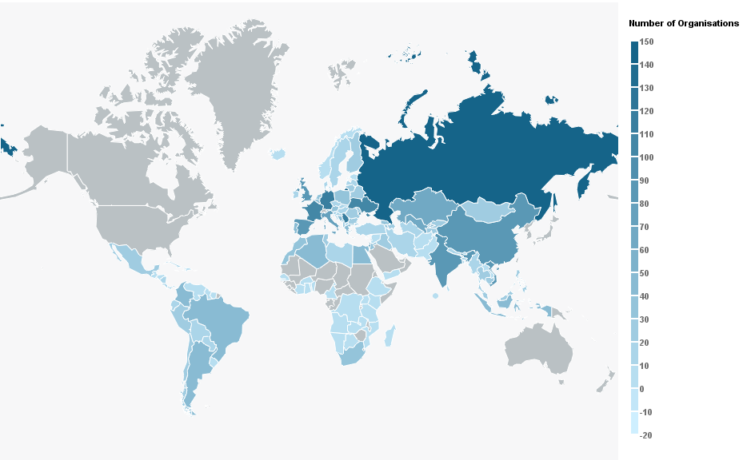
4 generations of CBHE projects
581 projects
147 coord. in a Prtnr Ctry (25%)
More than 3000 different orgs.
2200 different Universities (+ than 1500 in Prtnr Ctries)
R4
49
R1
68
R2
81
R7
70
R6
173
R3
142
R9
11
R8
62
R11
23
R10
18

Slide 13
Your partners : Accompanying your CBHE project
The European Commission
Policy making, priority setting
EACEA
Management of calls
Supports and monitors project implementation
At national level
National Agencies (Programme Cntries)
Impact evaluation
Budget allocation
Erasmus+ Offices (ex-Tempus cntries)
EU Delegations (all Prtnr Cntries).
Your Stakeholders
National authorities, HEI services/depts in the partner orgs., target groups and final beneficiaries;
Other CBHE projects in : your region / your HEI / your thematic area;
Notes:
Who are you partners in your CBHE journey?
European Commission with
DG EAC in charge of leading the education, culture and youth policies of the EU; responsible for the Erasmus+ programme in its internal and external dimensions
DG DEVCO and NEAR in charge of the relation between the EU and its partners, for closer cooperation for what concerns DG NEAR and development and cooperation for what concerns DEVCO
The EACEA is there to support the implementation of the CBHE Action but also many other actions and programmes funded by the EU in the fields of education, culture, citizenship, film and television, voluntary work in and outside the EU, etc.
There are also an array of organisations supported by the EU that will be able to assist you and render your activities more visible at national level. These are
The E+ National Agencies in 34 Programme Countries
The National Erasmus+ Offices in 27 partner countries formerly covered by the Tempus programme (South and East Neighbourhood, Western Balkans, Russia and Central Asia )
The EU Delegations in all the partner countries
Finally, it is of the upmost importance that your CBHE activities are not only implemented with your official partners and with the support of your EU interlocutors in Brussels or at national level, but that
On the one hand they involve all your local stakeholders
On the other hand they rely on the experience of those that have already implemented similar projects in your institution, your region or the thematic area you intend to address

Slide 14
THE CBHE TEAM AT EACEA
Notes:
HE Team in EACEA
2 monitoring teams organised by regions and composed of project officers. Each of the 18 PO monitors ca. 33 CBHE projects .
A Finance team composed of 14 colleagues in charge of the financial aspects of project management and who, during the implementation of your project (but also at final report stage) be responsible for ensuring that your grant is or has been used for the objectives of your project and in full compliance with the EU financial regulations as well as all the specific requirements applicable to CBHE projects.
Finally, last but not least there is also a Selection team of 5 colleagues without whom you would not be here today.
You will have the opportunity to meet all these colleagues during the next two days and I will come back to their work at the end of my presentation. In the meantime you can always play bingo and try to complete your card with the names of the 36 colleagues represented in this slide. In addition, I offer an extra Belgian beer to all those who will be able to identify 4 out of the 6 colleagues who were too shy to have their picture shown in this wall of fame.

Slide 15
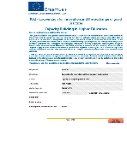
CBHE Rules and Regulations
EC E+ CBHE regulations
National Legislation
Your working arrangements
Institutional Practice
(Art II.19.1 (e) )
Notes:
Basically, you will have to work and comply with three different sets of rules, regulations, requirements, practices:
Those of the EC and E+ CBHE action
Those of the countries where your activities will be implemented
Those of the partner institutions and the institutions your project targets
In order to ensure you do so, you will have to design you own set or regulations and you own working arrangements under a Partnership Agreement that
constitutes a mandatory requirement for CBHE projects and that
similarly to the mandates constitutes a legally binding document among beneficiaries

Slide 16
Your proposal
10%
Your project environment
90%
Different
Individuals (/personalities)
Countries (/cultures, currencies, languages, time zones)
Legal requirements
Institutional constraints
Notes:
Your proposal = tip of the iceberg
90% of the work to be done is influenced by your project environment. Any % which is not controlled in the project environment will have an impact on the project implementation.
International cooperation projects are complex → the consortium will have to reconciliate:
Different cultures
Different ways to operate
Different currencies
Different languages
Different timezones
Different legal frameworks
Different local contraints
Etc.

Slide 17
Grant Agreement – Legal Provisions
Role and obligations of the Beneficiaries
Multi-beneficiary Grant Agreement
Mandates: contractual link between EACEA and all beneficiaries
All beneficiaries are jointly responsible
In case of recovery
In case of audits, checks or evaluation in their premises
Only organisations can be Beneficiaries
Partner country beneficiaries have specific obligations
Notes:
Let's start with the G.A
Importance of the notion of multi-beneficiary GA
All beneficiaries are jointly responsible for carrying out the project in accordance with the GA and have the same obligations. They are also jointly responsible in case part of the grant must be recovered, or if they are audited in their premises.
Only organisations can be beneficiaries (art 23 of the Erasmus+ Regulation)
From a contractual point of view, there are no more responsibilities for Partner Country beneficiaries than for Programme Country Beneficiaries, however from the operational point of view and for what concerns the quality and impact of the project, they have more responsibilities that their European partners.

Slide 18
PARTNER COUNTRY PARTNERS
Are responsible for:
Enhancing Project results relevance / added value
Raising awareness & disseminating results
Involving target groups and local stakeholders
Respecting national requirements / legal constraints
Ensuring implementation and sustainability of the project results
Inter-institutional cooperation projects
Only organisations can be beneficiaries
Notes:
National requirements / legal constraints = project registration, visa issues, VAT, tendering procedures, transfer of money, etc.
If necessary / relevant : National/regional coordinator = privileged contact point for the project coordinator
→ He/she must forward the information (received from the coordinator) to the partners in his/her country/region.

Slide 19
Your Grant Application
Forms an integer part of your Grant Agreement (Annex I).
Is the basis of your partnership cooperation
Its implementation has to be compliant with the three levels of external rules / regulations,
Can be adapted (does not affect the expected results, is compliant with the E+ CBHE rules) and/or amended
Notes:
Your grant application is the reason for which your project was selected. It is also the reason for which other projects were not selected.
As a result, at final report stage, it will be the basis on which the Agency will be able to determine if we were right or wrong in selecting you. Or in other words: if the activities envisaged and the results promised were achieved or not, both in volume and in quality.
It is also the core of the partnership cooperation modalities. In this respect, we are often confronted with partners who confess that they have not actually contributed to its preparation nor even read it! This is not acceptable and is usually a recipe for failure.
In order to make your project visible in the partner institutions it is of the upmost importance that
the full application is in the hands of each beneficiary organisation
The most important/relevant parts of it are translated in the national language of each of the participating organisations. This way you will be able to
Present and sell it to the relevant local bodies, organisations, stakeholders you aim to reach
Find support from these bodies
Encourage future similar cooperation projects
The fact you have proposed an activity or envisaged an expenditure in your application does not render it automatically eligible nor compliant with the mandatory rules and regulations your project has to respect. While EACEA will not be able to check the compliance with the relevant national legislations (it could be done though through audits), it will have to ensure that all expenditure incurred with the grant are fully compliant with the grant agreement and the CBHE regulation.
Finally it is to be expected that because of internal or external factors, a proposal drafted at the latest in the second half of 2017 will have to be adapted or even amended during its implementation phase.

Slide 20
BEFORE ASKING FOR AN AMENDMENT
Estimate the impact of the proposed change on the project:
Compare this change/deviation with the initial work plan
Make sure it stays within the scope of the project and complies with the programme's rules
Who does it affect – one partner/the whole partnership?
Does it have an effect on the project budget?
Does it have an effect on the project timeframe?
Any risk that the project will not deliver some of the planned outputs?
Reflect on alternative solutions (fall-back plan)
Inform and ask your Project Officer for advice.

Slide 21
YOUR PARTNERSHIP AGREEMENT (Art. I.10.5)
Objectives:
Formalise of internal project and grant management procedures
Institutional commitment to the project
Partnership conflict resolution
Guidelines available on Agency website
Negotiated with partners
Signed by Legal Rep.
Joint or Bilateral
Scanned copies to be submitted to EACEA at the latest 6 months after signature of G.A.
Notes:
Mandatory + must be signed at the latest 6 months after the signature of the grant agreement
Guidelines available on Agency website (should be adapted to the needs of the Partnership)
Joint parternship (one doc signed by all partners) is recommended because it is more transparent
Should be drafted in the working language of the consortium (and hopefully translated in the national language of the participating organisations)

Slide 22
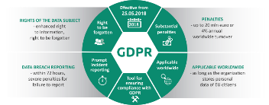
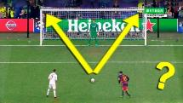
OTHER LEGAL ISSUES
Publicity and Dissemination (Art. Art. I.10.8, I.10.9, II.7.1)
Conflict of interest
(Art. II.4)
Data Protection
(Art. II.6)
Force majeure Suspension/Termination
(Art. II.14, II.15 & II.16)
Financial Penalties (Art. II.17)
Notes:
I will come back in more details on the Publicity and Dissemination requirements
But first of all it is important to refer briefly to other aspects of your GA that may have consequences and your final grant
Conflict of interest : this applies to all the aspect of your project and in particular to
The persons who will perform the work (e.g. if a person has been deisgnated to draft the dissemination plan it has to be for his/her expertise and not for his/her links with other actors of the project)
Those who will benefit from the work (e.g. if training activities are foreseen for students, staff or other stakeholders these have to be selected in acoordance with fully transparent criteria)
The individuals or organisations providing services or goods to the project under the subcontracting heading of the budget: more information during the Financial workshop.
General Data Protection Regulation : European institutions are all familiar with this acronym for a few months now (since May 2018) (even if I am afraid they are not fully aware of its scope and consequences). It is important to stress that the GDPR is applicable worldwide and to all organisations storing personal data of EU citizens. As a result, this applies also to non EU partners. Since I am not a specialist, I invite you to liaise with your European partners in order to ensure that all personal data collected and stored in the context of the project (and particularly the data of EU citizens) is used in full compliance with this Regulation
Force Majeure: unforceable, exception situation or event beyond the parties control which prevents them to fulfil their obligations.
Cannot be attributable to error, negligence, lack of preparation. CBHE experience has shown that in most of the cases "force majeure" has been invoked in the context of mobility activities (lack of visa, sickness, flight cancelled, etc.) >>> take insurances, plan well in advance.
Please be cautious: the Agency will analyse very carefully the activities for which costs are claimed although they have not been implemented
Inform EACEA immediately if this occurs
Termination / Suspension: any of the two parties can propose to suspend or terminate the GA according to a set a criteria that defined under articles II.15 and II.16 of it. Suspension will be envisaged if the project activities cannot continue for a certain period (either because of external factors or because of the need to clarify cooperation serious issues between the parties). Termination will be envisaged if external or external factors prevent the project to continue at all.

Slide 23
DISSEMINATION / PUBLICITY
Legal requirements in the Grant agreement
Visibility of project results (Art. I.10.8, I.10.9, II.7.1)
Availability of materials produced
Use correct logo and disclaimers
Stickers on purchased equipment
Important to define stakeholders and plan dissemination according to target groups
Internal and external target groups (incl. public authorities)
Dissemination at regional / national / international levels
Check Annex II of the Erasmus+ Programme Guide: Practical Guide on Dissemination and Exploitation
Notes:
While implementing your project you in a certain sense become ambassadors of the Erasmus+ Programme and the EU funds allocated to your partnership.
In this context it is
Mandatory to ensure that this financial support is clearly advertised
Article I.10.8 on Dissemination
Article I.10.9 Publicity Obligations
Article II.7.1 of Visibility of the EU funding (logos, disclaimers)
Obligation to use stickers
Mandatory to make you project results available for dissemination purposes
Mandatory to ensure that in your activities or your project results, you do not attempt to the image of the EU and its institutions (i.e. the disclaimer)
Internal dissemination often tends to be forgotten – make sure that the project and its results are known at each partner institution!
Stakeholders to keep in mind for dissemination (internal & external):
Staff (at partner/non partner HEIs)
Students (at partner/non partner HEIs)
Graduates
Enterprises
National Authorities
Governmental organisations
Etc

Slide 24
VISIBILITY RULES
Project publications and results (Art. I.10.9):
Must display Erasmus+ Logo
Must include this sentence: " Co-funded by the Erasmus+ Programme of the European Union"
Must include disclaimer:
"This project has been funded with support from the European Commission. This publication [communication] reflects the views only of the author, and the Commission cannot be held responsible for any use which may be made of the information contained therein".
See Agency's website:
https://eacea.ec.europa.eu/about-eacea/visual-identity_en
http://ec.europa.eu/dgs/education_culture/publ/graphics/beneficiaries_all.pdf

Slide 25
DISSEMINATION OBLIGATIONS (Art. I.10.8)
Mandatory project website
Launch at project start
Informative & attractive ALSO for wider public
Content: Project description/objectives, management structure, project outputs (dates of events, trainings, meeting etc), results of project activities
Mandatory use of the Erasmus+ Projects Results Platform:
http://ec.europa.eu/programmes/erasmus-plus/projects/
Other dissemination tools : project flyers/leaflets/brochures; Media releases, newsletters, articles in specialised press; Social media: blogs, Facebook, Twitter; Public events, meetings, seminars.

Slide 26
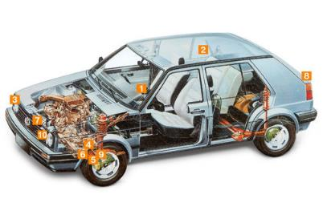
PENALTIES
Breach of contractual obligations
(Art II.17)
2 to 10% of the grant + admin. penalties
Publicity
(art I.10.10)
Visual identity
Disclaimer
Up to 20% of max grant
Weak implementation (Art. I.10.6)
25 to 75% of the max grant
Notes:
Clauses related to possible penalties:
I.10.10: non-compliance with publicity obligations (penalty up to 20% of the grant).
Visibility obligations listed in article II.7.1:
Displaying the EU emblem with necessary sentence
Obligation to indicate that the action benefits from EU funding
Obligation to include disclaimer
Obligation to label the equipment purchased with the grant
II.17 Administrative and financial penalties
In case of substantial errors, irregularities, fraud, false declarations or serious breach of contractual obligations
Administrative penalties (exclusion from contracts and grants)
Financial penalties (2-10%)
I.10.6 Poor, partial or late implementation
As said earlier at final report stage, the Agency will compare the project results with what had been promised in the application in order to decide if the project was implemented accordingly.
This will concern the nature of the result/activity, its volume, its quality, its relevance and the timing of its implementation
If a QA plan had to be produced we will check if this is the case, if the number of staff days claimed for its production is reasonable in view of its quality, if it has been properly implemented (e.g. the plan foresaw biannual reports from an external evaluators but this never took place)
The same can be said about the purchase of equipment that was supposed to be used for training the students as from year 2 but was only purchased in the last semester of the project.
All these case will be assessed and will influence the final note given to your project on a scale of 100 pts. Penalties will start to apply as from 49 pts.
Please note that the publicity and implementation penalities are calculated on the maximum grant and not on the grant spent.

Slide 27
Here they are again!
Notes:
4 teams:
Selection team in charge of publishing the call for proposals, evaluating the applications received, selecting projects.
2 monitoring teams organised by regions and composed of project officers. Each PO monitors ca. 30 projects (both Tempus and CBHE).
Finance team: in charge of the financial aspects of project management.

Slide 28
EACEA MONITORING and SUPPORT
A Project Officer (PO) has been assigned to your project with the objective of:
Ensuring the project is on track and respects CBHE requirements
Supporting the partnership during the project implementation
Anticipating difficulties
Identifying best practices
Monitoring through
Regular email / telephone communication with the coordinator
Organisation of video-conferences
Assessment of reports, requests for amendment
Visits to projects (individual visits or in the context of cluster meetings)
Monitoring intensity based on "risk assessment"

Slide 29
Your project will be monitored…
On an on-going "ad hoc basis" whenever considered necessary;
On a "periodic basis" in accordance with the following timetable
Now | During this GH Meeting in the context of the bilateral meeting & other networking occasions
6 months after your project started | When you will deliver your Partnership Agreement it will be the moment when your PO will check your website, ensure a quick off meeting has taken place as well as payment to partners, etc.
At Mid term | At progress report stage you will be provided with his/her detailed recommendations
6 months before project end | The PO will ensure that all activities have been implemented, the equipment has been purchased and used, the partners have been paid.
After the end of the project | In the context of your final report

Slide 30
EACEA FIELD MONITORING
Aim of Field Monitoring
Check that the project advances according to the work plan
Check that partners are fully involved in the project
Prevent problems due to weak project implementation (penalties!)
Special emphasis on the visibility / sustainability/impact of the project results in the partner country(/-ies)
Format
Conducted by EACEA / NEO / EU Delegation
At coord. HEI / at Partner Country partner / during consortium meeting
Interview of project actors / visit premises (/equipment)
Recommendations by EACEA to the partnership
Please note that the monitoring intensity is based on a "risk assessment"

Slide 32
QUESTION NOT ANSWERED?
Please contact the E+CBHE team
<<mypo>>@ec.europa.eu
AND
EACEA-EPLUS-CBHE-PROJECTS@ec.europa.eu
Do not forget to mention your project number!
Notes:
Please use this mailbox when sending your e-mails, with your PO in Cc.

