Slide 1
Entrepreneurial bootcamp A musicians footprint Photo Album
by Dušanka Jelenković Vidović

Slide 2
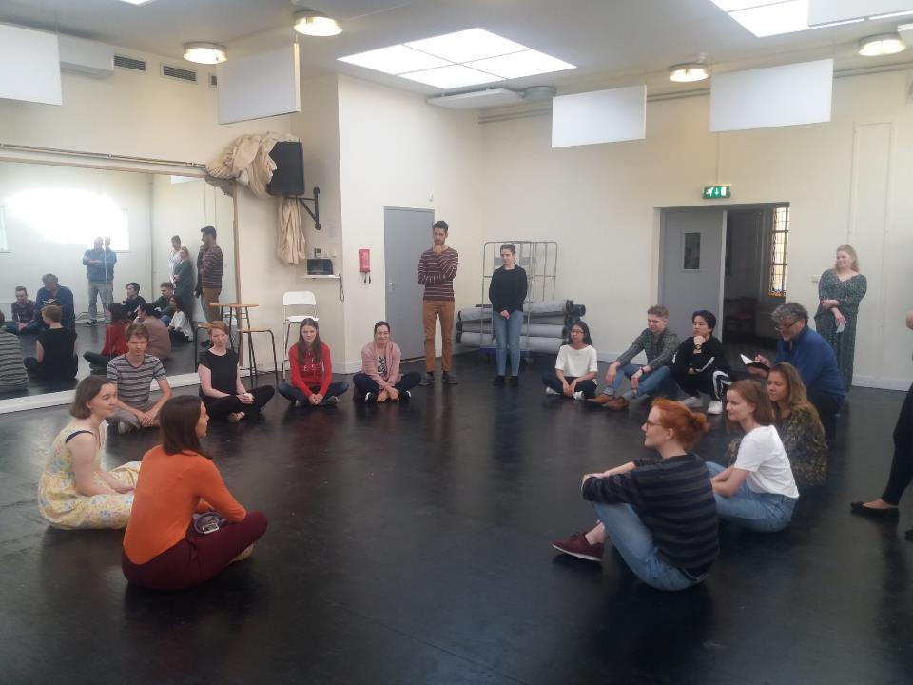
Notes:
Please let me introduce… Introducing the aspect of interviewing and exploring context and location.

Slide 3
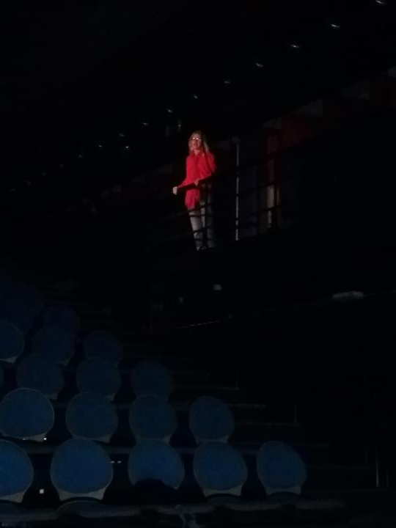
Notes:
Please let me introduce… Introducing the aspect of interviewing and exploring context and location.

Slide 4
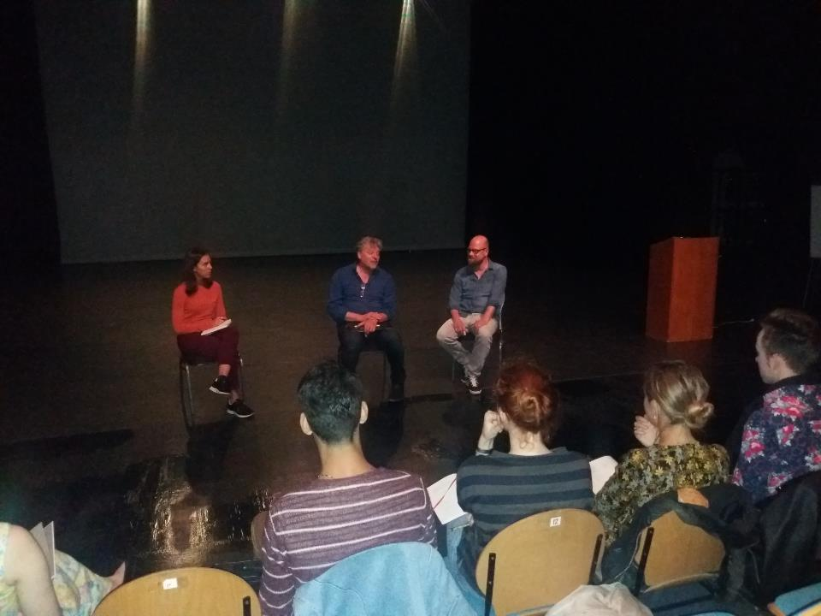
Notes:
Explore your playground. Instruction for how to explore playground and prepare pitch

Slide 5
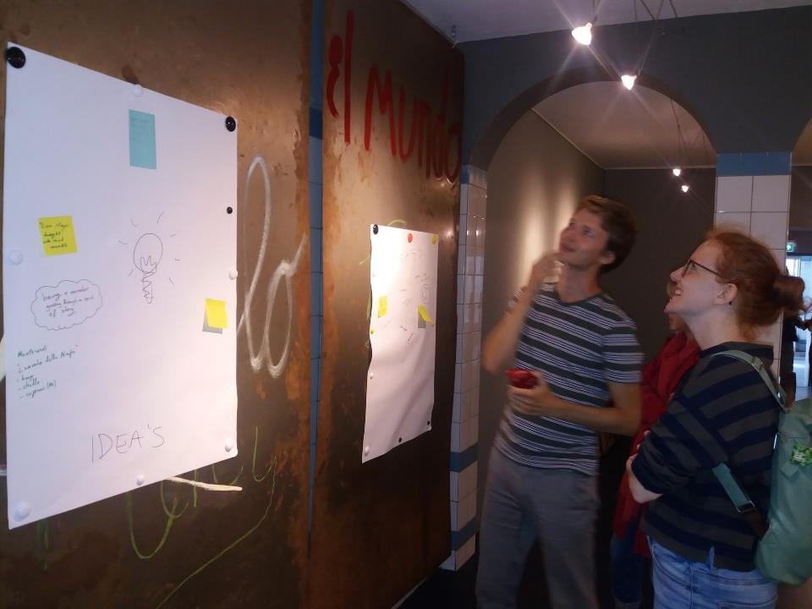
Notes:
Choose your band. Each student has two post-it stickers in different colors: blue for first choice, yellow for second choice. On each sticker they write their name, instrument or voice-type and they add one or more ‘specialisms’.

Slide 6
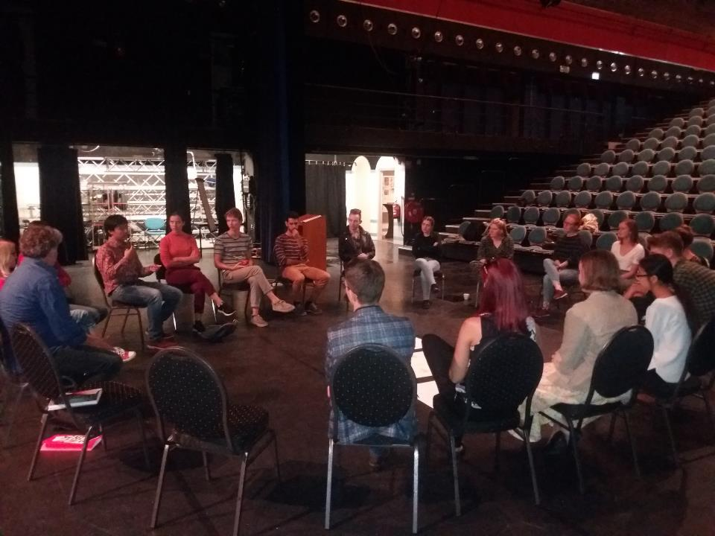
Notes:
Our strategy & BDOP. Designing a strategy for coping with conflicts in the group and writing a BDOP (Brief Description of Project) per group

Slide 7
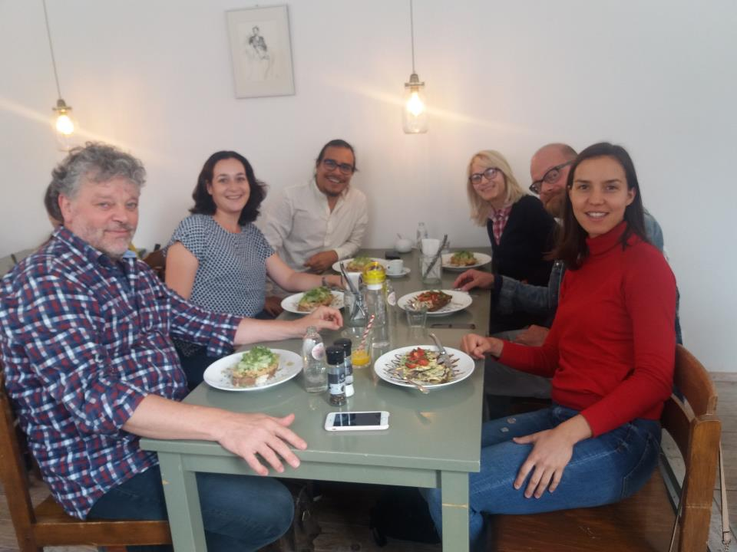
Notes:
Hosts and guests ☺

Slide 8
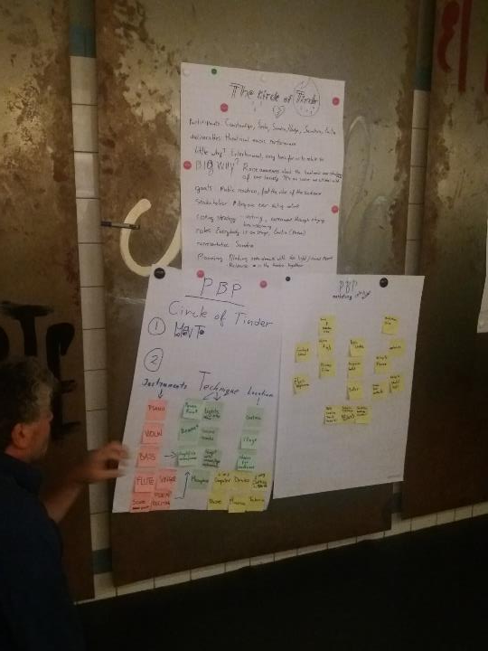

Slide 9
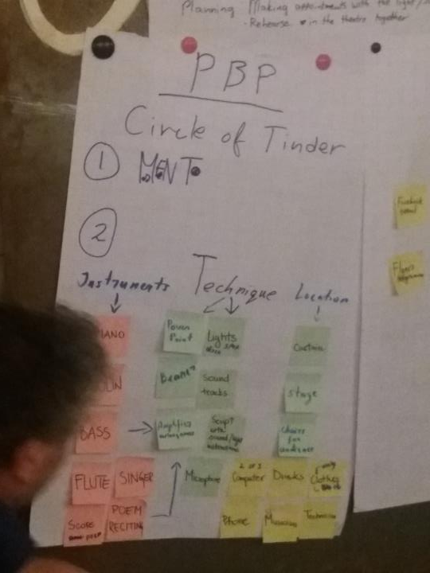

Slide 10
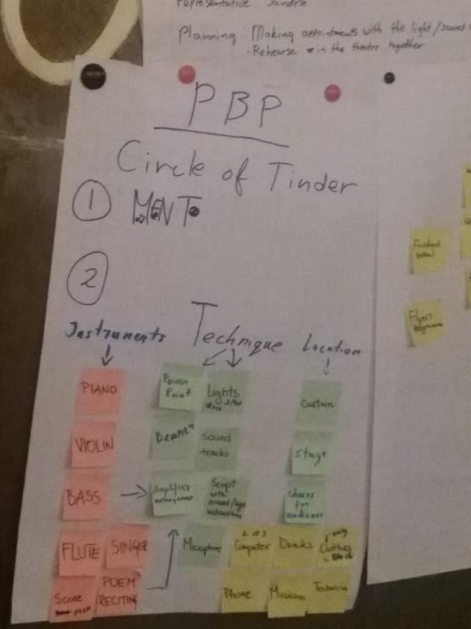

Slide 11
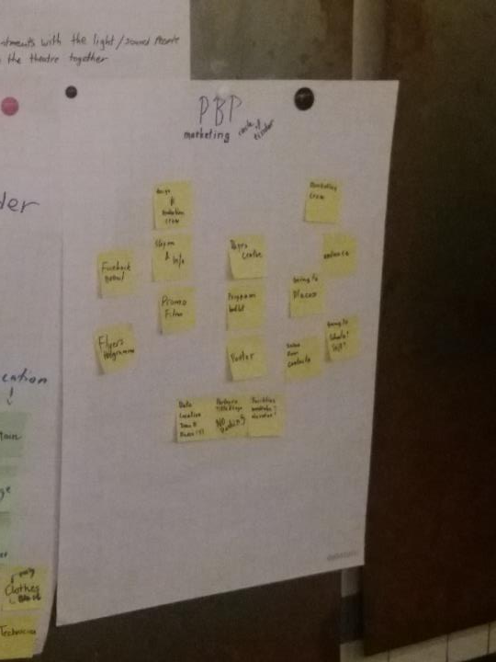

Slide 12
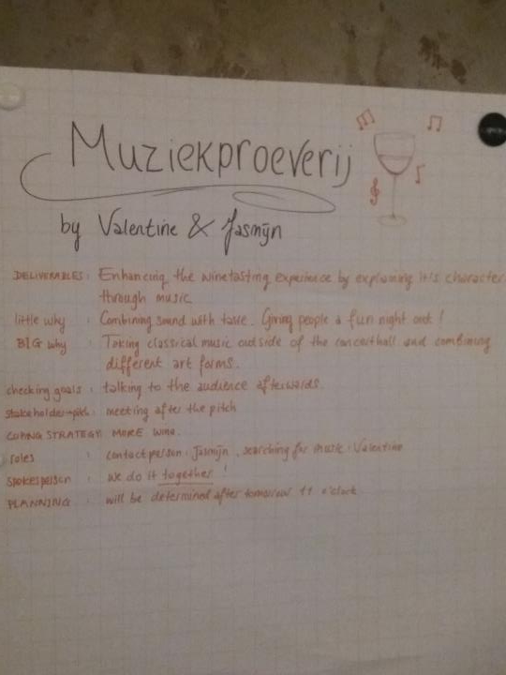

Slide 13
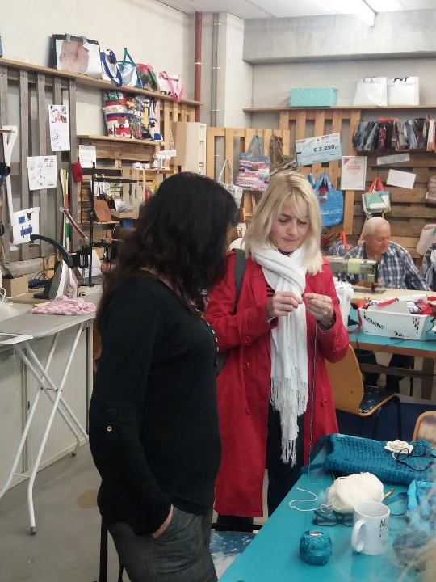

Slide 14
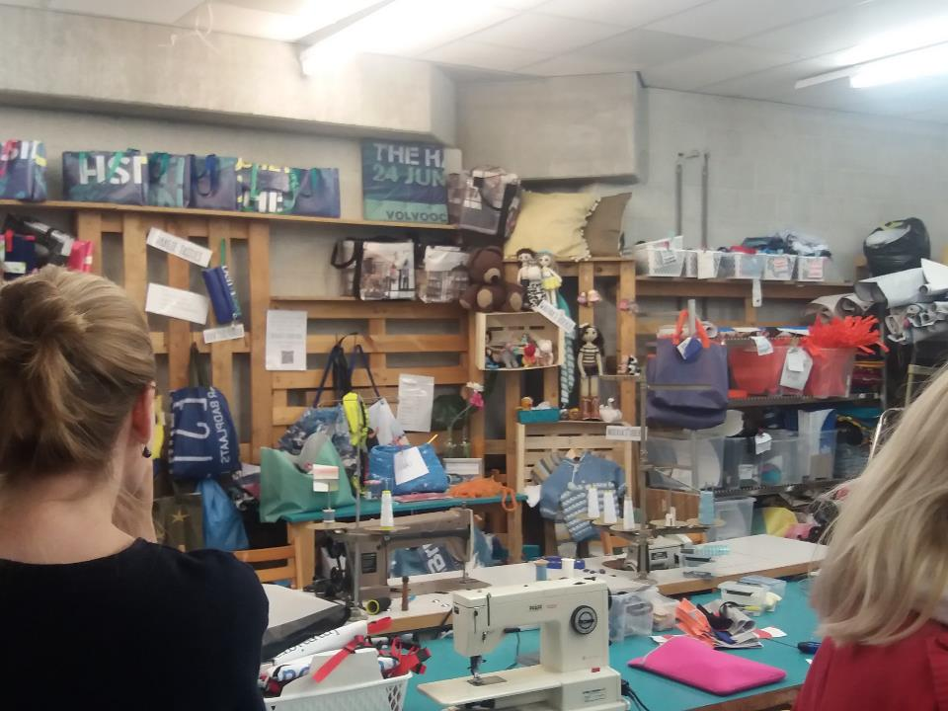

Slide 15
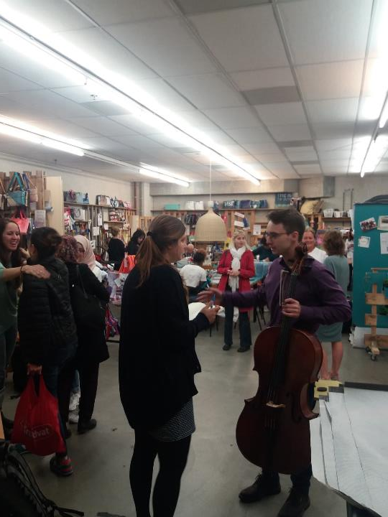

Slide 16
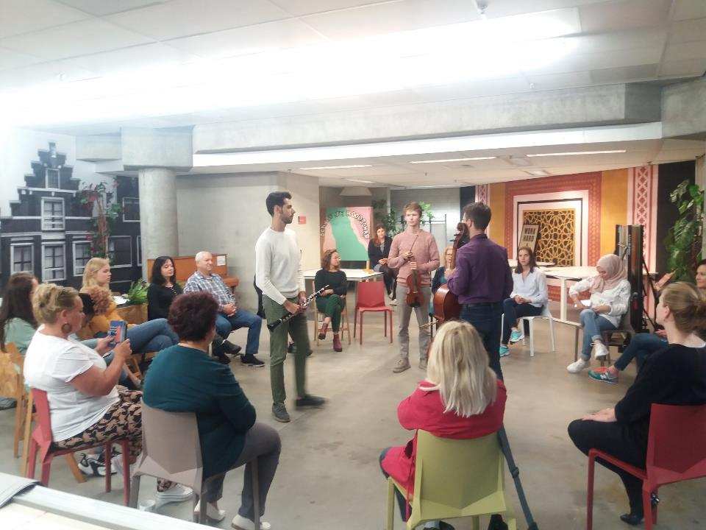
Notes:
Show time. Mijn Buuf (my neighbour)

Slide 17
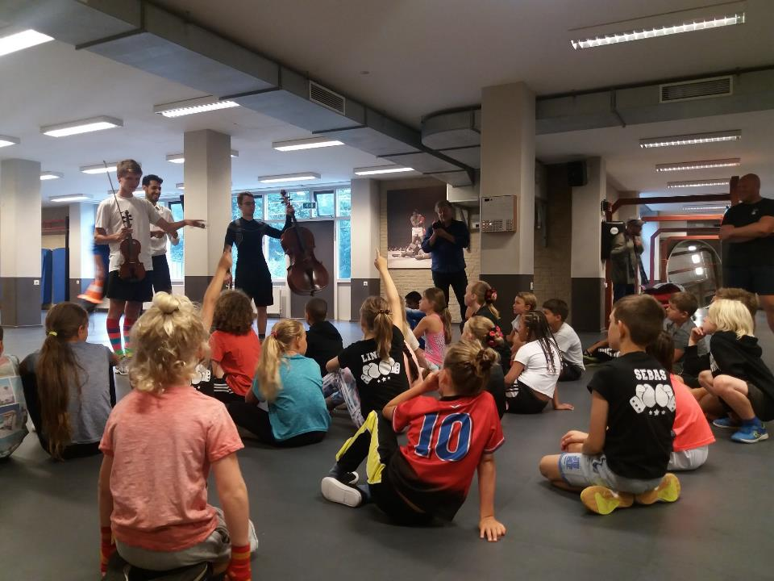
Notes:
Show time. Boxing school

Slide 18
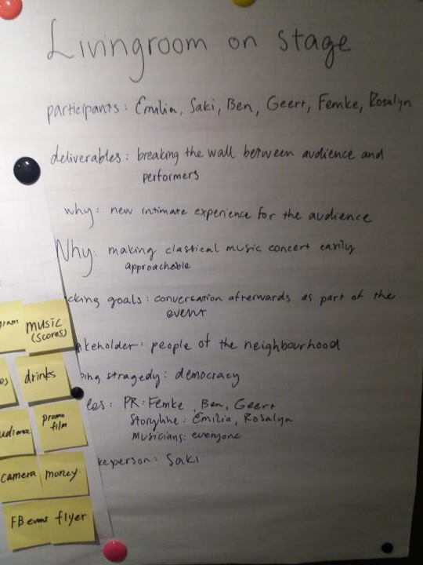

Slide 19
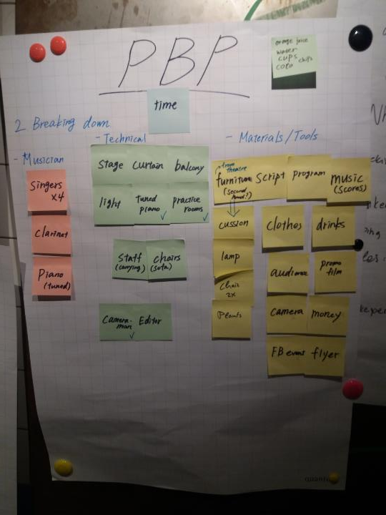

Slide 20
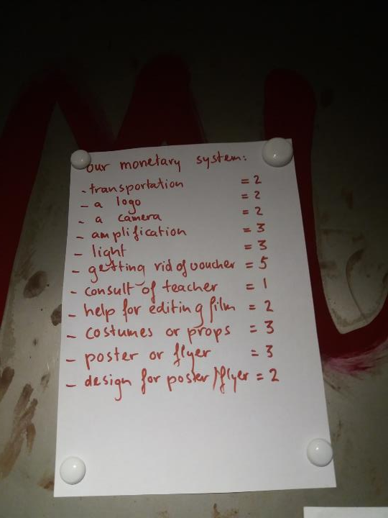

Slide 21
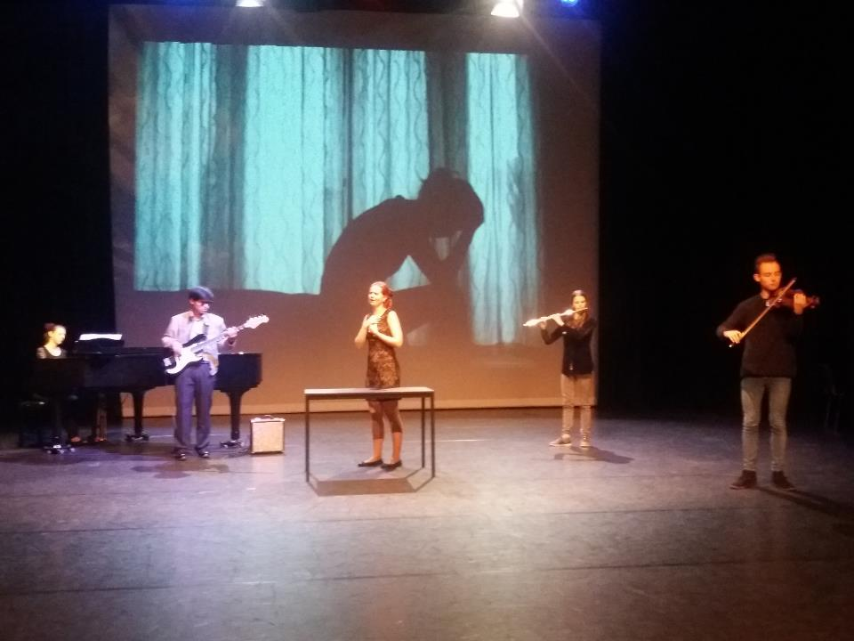
Notes:
Show time. The circle of Tinder

Slide 22
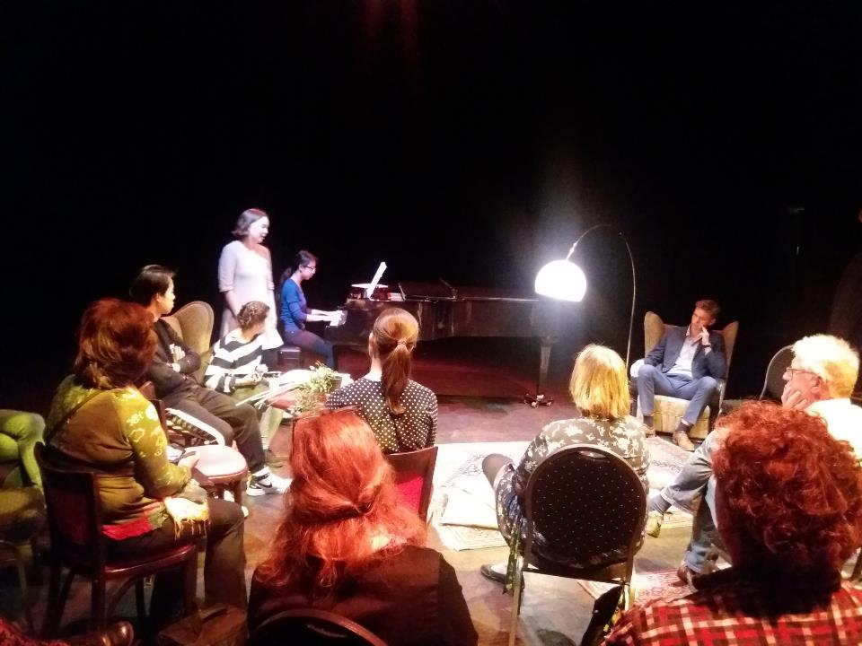
Notes:
Show time. Living room on stage

Slide 23
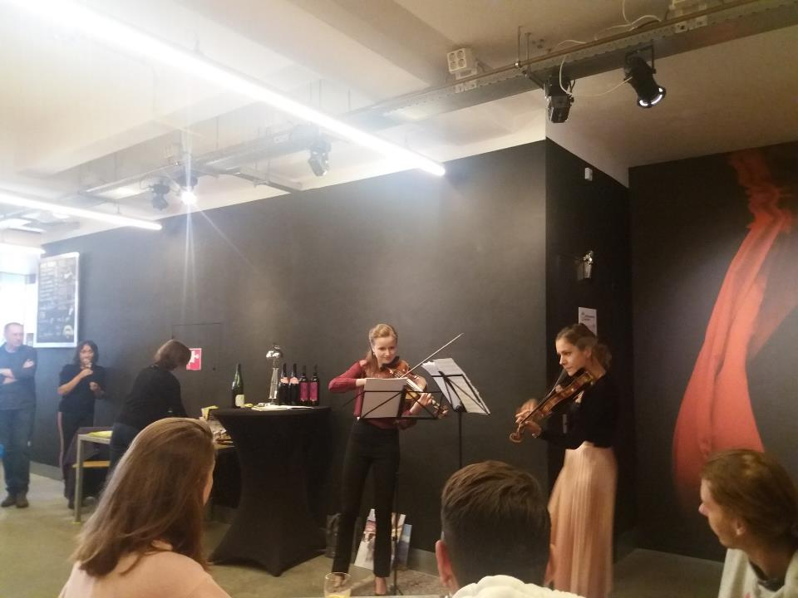
Notes:
Show time. Vino Vero

Slide 24
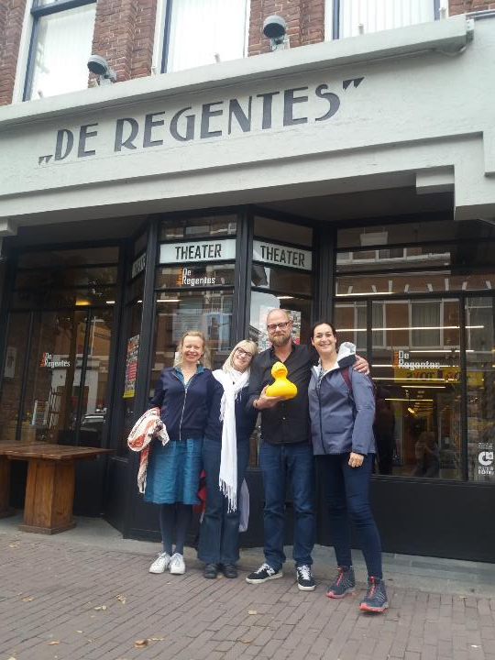

Slide 25
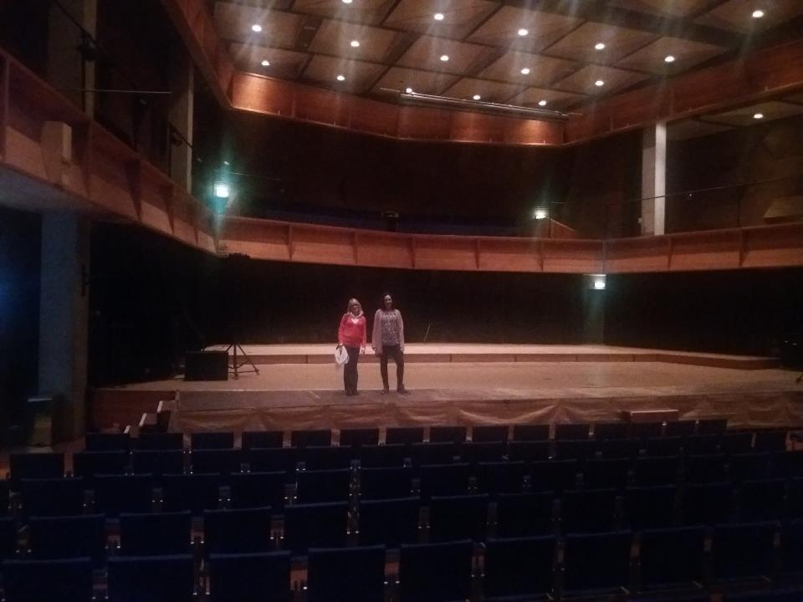

Slide 26
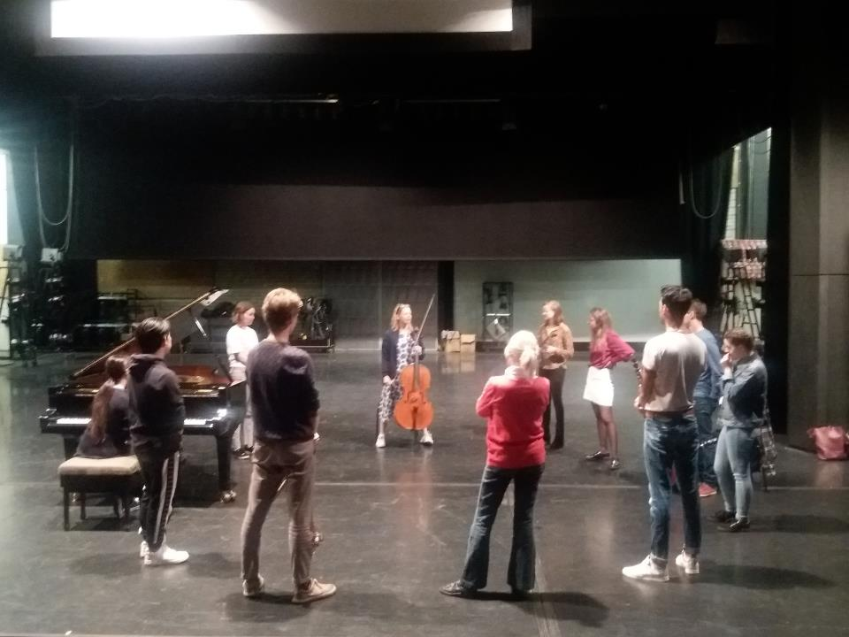
Notes:
Improvisation workshop with Tanja Orning (KMH Oslo, Norway)

Slide 27
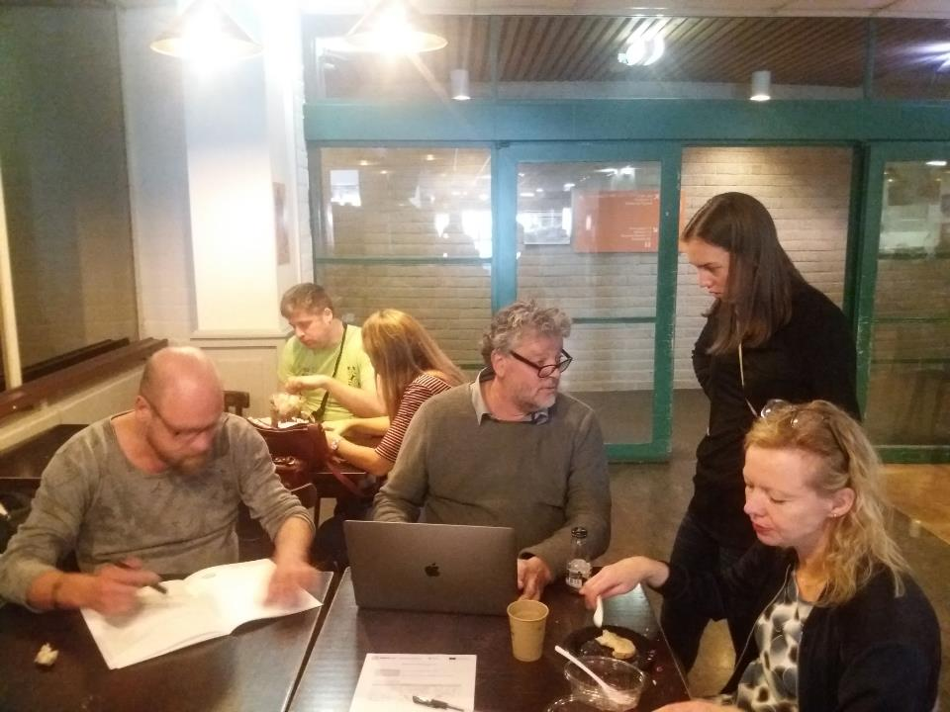

Slide 28
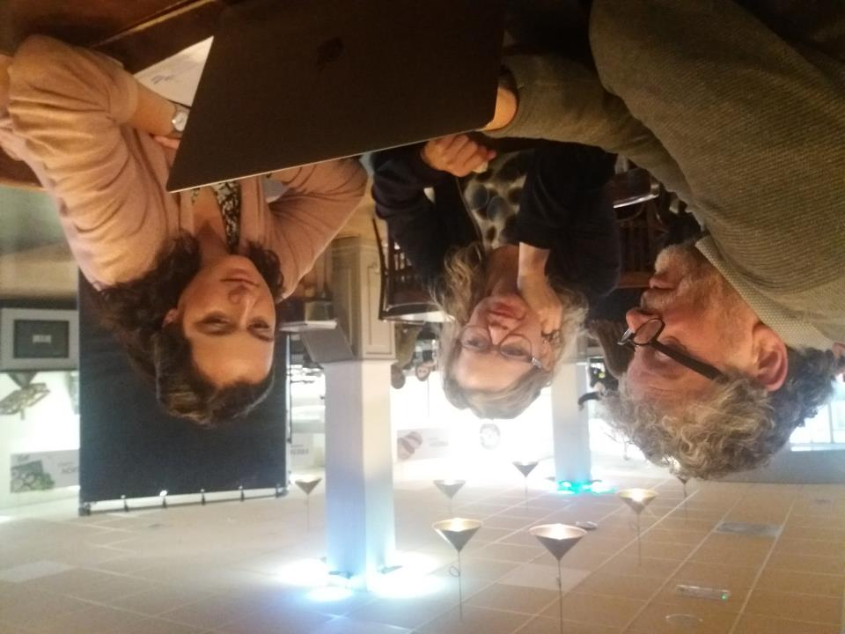

Slide 29
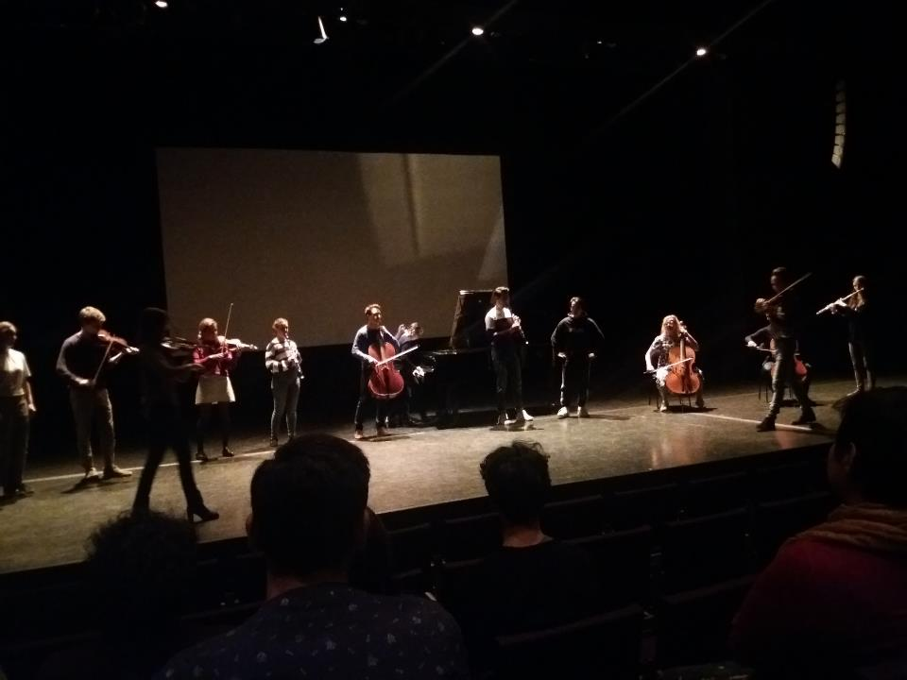
Notes:
Presentations in FYF and RC

Slide 30
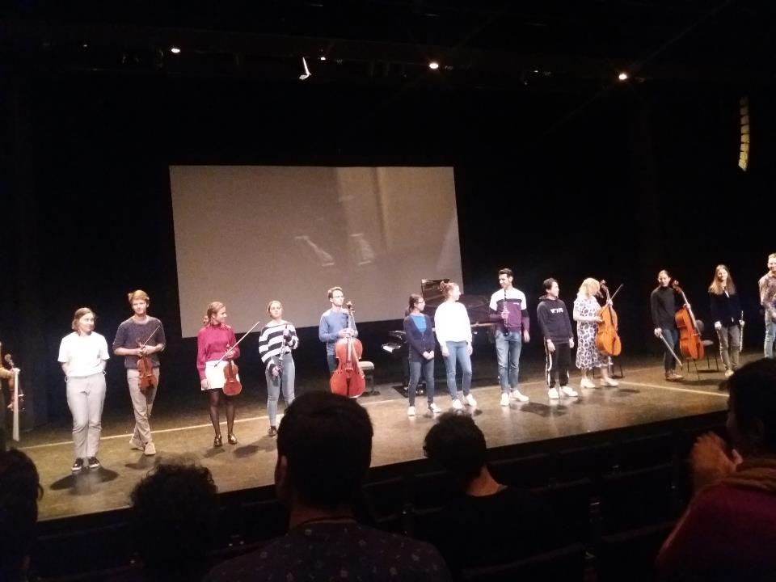
Notes:
Presentations in FYF and RC

Slide 31
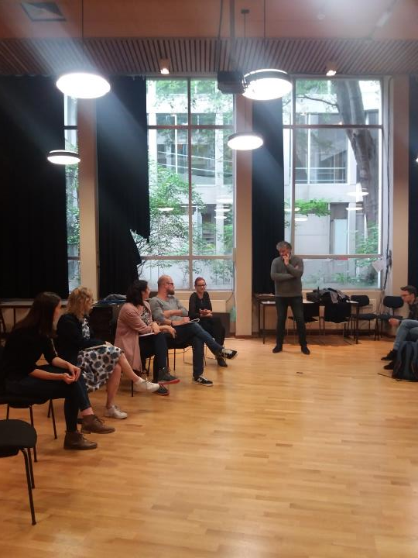
Notes:
Critical reflection and evaluation

Slide 32
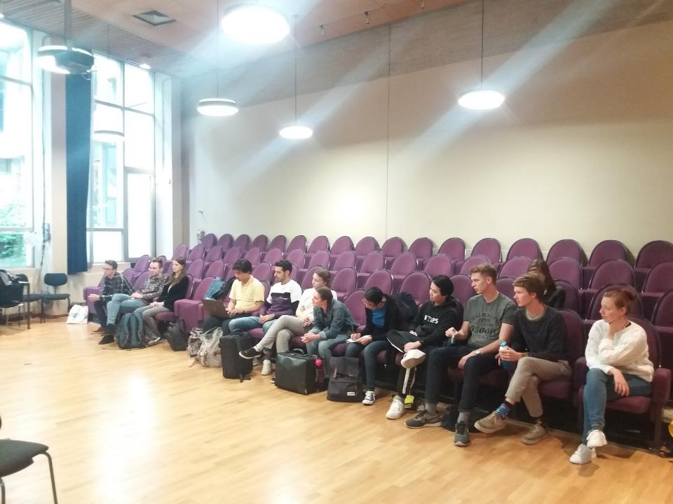
Notes:
Critical reflection and evaluation

Slide 33
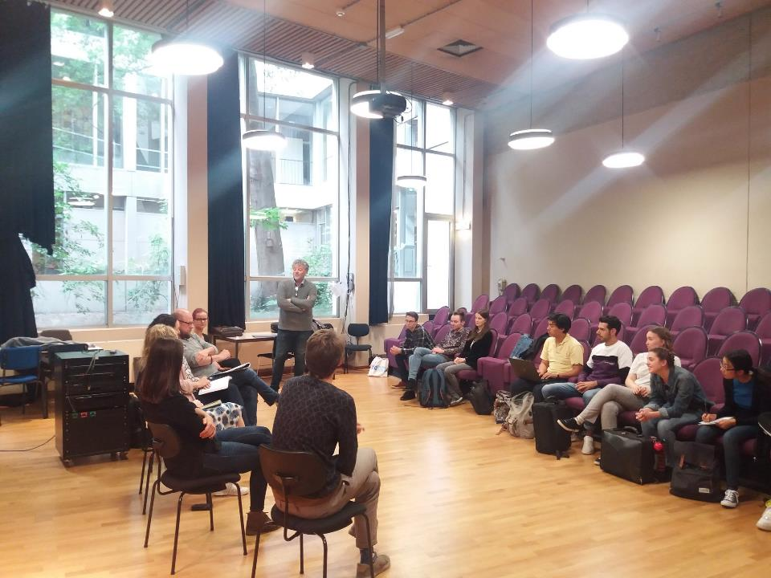
Notes:
Critical reflection and evaluation

Slide 34
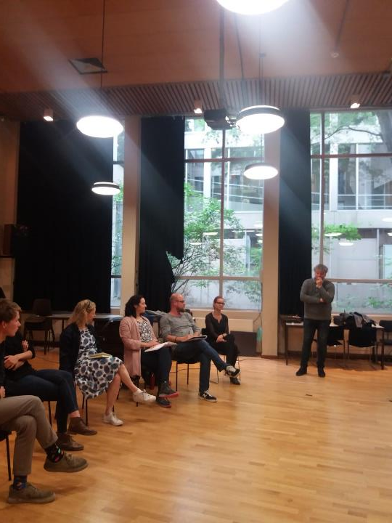
Notes:
Critical reflection and evaluation

Slide 35
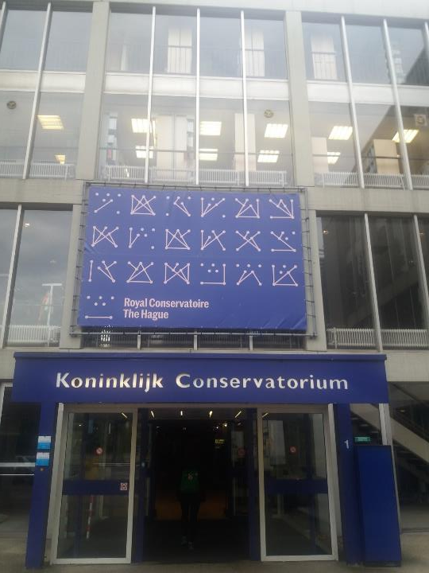
Notes:
Thank you Royal Conservatoire The Hague for you kind hospitality!

